Slide 1




Slide 2

TEST TIME ON MAXIMUM PRODUCT SUBARRAY
URL:https://forms.gle/4LD4LutpGGuCE5zR8
QR CODE:

Slide 3

MAXIMUM SUM OF HOURGLASS IN MATRIX

Slide 4
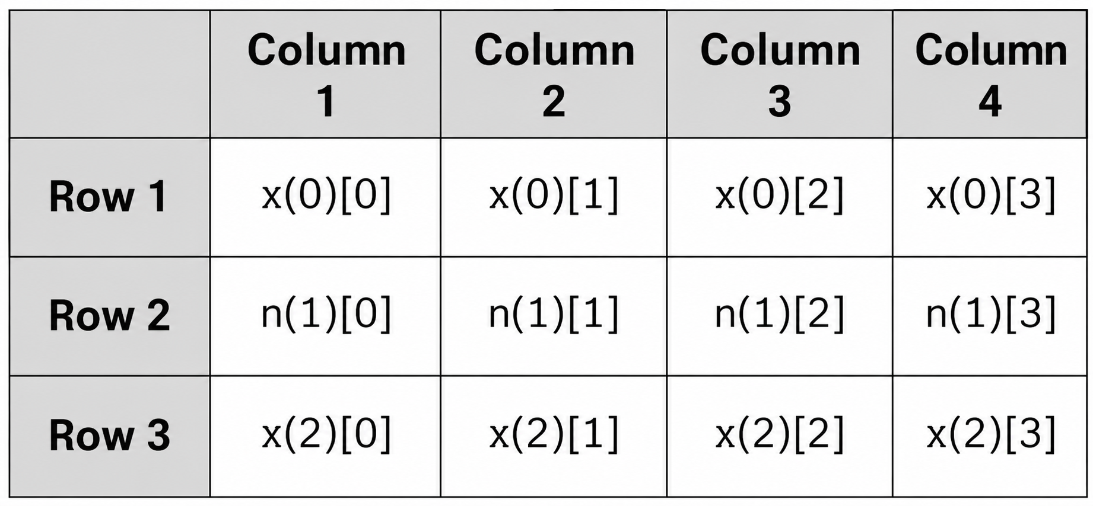
MAXIMUM SUM OF HOURGLASS IN MATRIX
Introduction: Finding the hourglass pattern with the maximum sum in a matrix.
In this problem, we have a matrix i.e. two-dimensional (2D) array.
Example:
We have to find the maximum sum of the hourglass value of a matrix.

Slide 5

MAXIMUM SUM OF HOURGLASS IN MATRIX
Introduction: Hourglass
The hourglass concept in the algorithm comes from the device which is used to measure the passage of time.
The device is called sandglass.

Slide 6
MAXIMUM SUM OF HOURGLASS IN MATRIX
Introduction:
X X X
X
X X X
Hourglass format:
Hourglass is a 7-element shape made in the matrix in the following form:

Slide 7
MAXIMUM SUM OF HOURGLASS IN MATRIX
Important note:
The number of rows or columns of hourglass must be equal to 3 i.e. three index values at the top, one in the middle, and three at the bottom
The total number of hourglasses in a matrix is equal to (R-2) * (C-2), where R refers to the number of Rows and C refers to the number of Columns.
TOP
MIDDLE
BOTTOM

Slide 8
MAXIMUM SUM OF HOURGLASS IN MATRIX
Problem Statement
Given a 2D matrix of integers, find the minimum hourglass sum. An hourglass is defined as a subset of elements with the following pattern:
The sum of an hourglass is: a + b + c + d + e + f + g
a b c
d
e f g

Slide 9
MAXIMUM SUM OF HOURGLASS IN MATRIX
Task:
Identify all possible hourglasses in the matrix
Compute their sums
Return the minimum sum
Constraints:
Matrix size ≥ 3 × 3
Elements can be positive, negative, or zero.

Slide 10
MAXIMUM SUM OF HOURGLASS IN MATRIX
Example Input and Output
All the possible hourglass in this Matrix are:
Example 1:
Let Rows = 5 Columns = 5
Matrix is: 1 2 4 5 6 7 5 2 3 6 0 0 0 0 0 7 5 1 3 5 0 0 0 0 0
1 2 4 2 4 5 4 5 6 5 2 3 0 0 0 0 0 0 0 0 0
7 5 2 5 2 3 2 3 6 0 0 0 7 5 1 5 1 3 1 3 5
0 0 0 0 0 0 0 0 0 5 1 3 0 0 0 0 0 0 0 0 0
Maximum sum of hourglass is 27

Slide 11
MAXIMUM SUM OF HOURGLASS IN MATRIX
Example 2:
Consider the
Rows = 4 Columns = 4
Matrix:-
2 4 0 0
0 1 1 0
4 2 1 0
0 3 0 1
Hourglass can be created using the following indexes:-
matrix [i][j]
matrix[i][j+1]
matrix[i][j+2]
matrix[i+1][j+1]
matrix[i+2][j]
matrix[i+2][j+1]
matrix[i+2][j+2]
We will find the sum of all these elements of the array from [0][0] to [R-2][C-2] starting points. And the find the maxSum for all these hourglasses created from array elements.

Slide 12
MAXIMUM SUM OF HOURGLASS IN MATRIX
The hourglasses are :
2 4 0 0 1 1
1 2
4 2 1 0 3 0
4 0 0 1 1 0
1 1
2 1 0 3 0 1
Maximum sum of hourglass is 14

Slide 13
MAXIMUM SUM OF HOURGLASS IN MATRIX APPROACHES
Prefix Sum
Used for fast submatrix sum
Hourglass is irregular shape (not rectangle) Not suitable / no real benefit
Brute Force (Nested Loop)
Traverse all possible hourglass positions
Calculate sum manually
Track minimum
Time: O(n × m), Space: O(1)
Practical Approach
Memory
Based Optimization
Sliding Window
Try to reuse previous computation
Shape changes → hard to maintain Not practical
Conceptual Optimization

Slide 14
WHY BRUTE FORCE IS PRACTICAL (Used) ?
Every hourglass must be checked at least once No effective reuse possible due to shape Already optimal: O(n × m)
Conclusion: Brute Force is the most efficient and practical approach for this problem

Slide 15
MAXIMUM SUM OF HOURGLASS IN MATRIX ALGORITHM
Step 1: Start the program and read the number of rows and columns
Step 4: Initialize: min_sum = Integer.MAX_VALUE
Step 2: Input all matrix elements into a 2D array
Step 3: Check whether the matrix size is at least 3 × 3. If not possible, print message and stop

Slide 16
MAXIMUM SUM OF HOURGLASS IN MATRIX ALGORITHM
Step 8:Update the minimum value if the current sum is smaller
Step 9:Print the minimum hourglass sum and end.
Step 5:Traverse all possible hourglass positions using nested loops, Outer loop → rows (0 to row - 3) & Inner loop → columns (0 to col - 3).
Step 6:Calculate the hourglass sum for each position
Step 7:Compare the current sum with the minimum sum

Slide 17
MAXIMUM SUM OF HOURGLASS IN MATRIX PSEUDOCODE
START
Read row and col
Create matrix[row][col]
Read all matrix elements
max_sum = minimum integer value
FOR i = 0 to row - 3
FOR j = 0 to col - 3
sum = matrix[i][j] + matrix[i][j+1] +
matrix[i][j+2] + matrix[i+1][j+1] + matrix[i+2][j]
+ matrix[i+2][j+1] + matrix[i+2][j+2]
IF sum > max_sum
max_sum = sum
END FOR
END FOR
Print max_sum
STOP

Slide 18
MAXIMUM SUM OF HOURGLASS IN MATRIX PROGRAM
import java.util.*; class Main { static int findMaxSum(int[][] mat) { int row = mat.length; int col = mat[0].length; if (row < 3 || col < 3) { System.out.println("Not possible to form hourglass"); return -1; } int max_sum = Integer.MIN_VALUE; | for (int i = 0; i <= row - 3; i++) { for (int j = 0; j <= col - 3; j++) { int sum = mat[i][j] + mat[i][j + 1] + mat[i][j + 2] + mat[i + 1][j + 1] + mat[i + 2][j] + mat[i + 2][j + 1] + mat[i + 2][j + 2]; max_sum = Math.max(max_sum, sum); } } return max_sum; }
Notes:
Maximum sum of hour glass = 13

Slide 19
public static void main(String[] args) { Scanner sc = new Scanner(System.in); // Input rows and columns int row = sc.nextInt(); int col = sc.nextInt(); int[][] mat = new int[row][col]; // Matrix input for (int i = 0; i < row; i++) { for (int j = 0; j < col; j++) { mat[i][j] = sc.nextInt(); } } | int result = findMaxSum(mat); if (result != -1) { System.out.println("Maximum sum of hourglass = " + result); } sc.close(); } }
Notes:
Maximum sum of hour glass = 13

Slide 20
MAXIMUM SUM OF HOURGLASS IN MATRIX TIME AND SPACE COMPLEXITY
Time complexity: O(R*C) where R is the number of Rows,C is the number of columns
Space complexity: O(1)
No extra data structure is used for computation
Notes:
Maximum sum of hour glass = 13

Slide 21
MAXIMUM SUM OF HOURGLASS IN MATRIX REAL TIME APPLICATIONS
AI & Computer Vision
Pattern recognition and detection.
Detecting bright pixel regions.
Weather & Heat Map Analysis
Image
Processing
Identifying high-temperature areas.
Game
Development
Finding high-scoring patterns.

Slide 22
Interview questions
Asked in Zoho (2025) – MCQ
Question: If a matrix contains negative values, what is the correct initialization for finding the maximum hourglass sum?
A) int max = 0; B) int max = -1; C) int max = Integer.MIN_VALUE; D) int max = 1;
.
Answer: C
Explanation:
To correctly handle cases where the array contains negative values, max should be initialized with Integer.MIN_VALUE, ensuring that the maximum value is captured accurately.

Slide 23
Interview questions
Asked in TCS (2024) – MCQ
Question:
What will be the output of the following logic for a 3×3 matrix?
1 1 1
0 1 0
1 1 1
A) 6 B) 7 C) 8 D) 9
Answer: B) 7
Explanation: Hourglass sum = 1+1+1 + 1 + 1+1+1 = 7

Slide 24
Interview questions
Question:
Which of the following modifications is required to convert a maximum hourglass sum solution into a minimum hourglass sum solution?
A) Change loop conditions B) Replace Math.max() with Math.min() and use Integer.MAX_VALUE C) Reverse the matrix D) Sort the matrix
Asked in Accenture (2023) – MCQ
Answer: B
Explanation: Only the comparison logic changes, traversal remains same.

Slide 25
Example Problem Statement
A climate research team is analyzing temperature data collected from different regions. The data is stored in a 2D matrix, where each element represents the temperature at a specific location.
To detect unusual cold patterns, the team focuses on a special formation called an hourglass, which consists of 7 elements arranged as:
a b c
d
e f g
Each hourglass represents a cluster of nearby regions. The total temperature of a cluster is calculated by summing all 7 elements of the hourglass.
Asked in Nutanix Maximum Sum of an Hourglass - 2025

Slide 26
Your Task:
Write a program to:
Identify all possible hourglass patterns in the matrix
Calculate the sum of each hourglass
Determine and print the minimum hourglass sum
Input Format:
The first line contains two integers N and M (rows and columns)
The next N lines contain M integers each
Output Format:
Print a single integer representing the minimum hourglass sum

Slide 27
Constraints:
3 ≤ N, M ≤ 100
-100 ≤ matrix values ≤ 100
Note:
An hourglass can only be formed if the matrix has at least 3 rows and 3 columns.
Solution:
LeetCode Hourglass Solution

Slide 28


Help Desk
Any concerns related to attendance/marks/ faculty ; you can reach out to ETHNUS helpdesk through the displayed QR code
https://codemithra.com/vit-helpdesk/

Slide 29




THANK YOU
+91 78150 95095
codemithra@ethnus.com
www.codemithra.com

